Slide 2
QWiki
Category​ : | Internal Tools and Processes
Idea Title : | Build a RAG based AI Assistant for Functional and Developer Queries
Team Members​ | Chetan Chauhan Geetali Bendale Shruti Maliye
Problem Description​ : | Build a RAG (Retrieval Augmented Generation) based AI Assistant that can answer documentation related queries about some process related queries from developers and will provide the relevant wiki or KB articles as references for its answers for the user to explore further. We'll be giving input as the wiki and KB articles we have and based on user's queriers the RAG will reference the previously provided wiki and KB articles and answer the user's queries. Also we're thinking of extending and using our current ppt's and word documents that we use as documentation for our products to answer any functional queries for our products as well. Another thing that we're thinking of to have as a stretch goal is to also process the transcripts of the brownbag sessions we have as part of our input data. reframe as a project idea
Notes:
Note: Please be clear on where did you start on the first day of HaQathon.

Slide 3

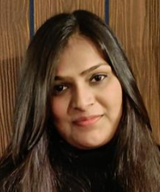

Team Members
Chetan Chauhan Senior Software Engineer
Transportation Team, Pune
Geetali Bendale Software Engineer 1
Transportation Team,Pune
Shruti Maliye
Software Engineer 1
Midstream Team, Pune
Notes:
Note: Please be clear on where did you start on the first day of HaQathon.

Slide 4
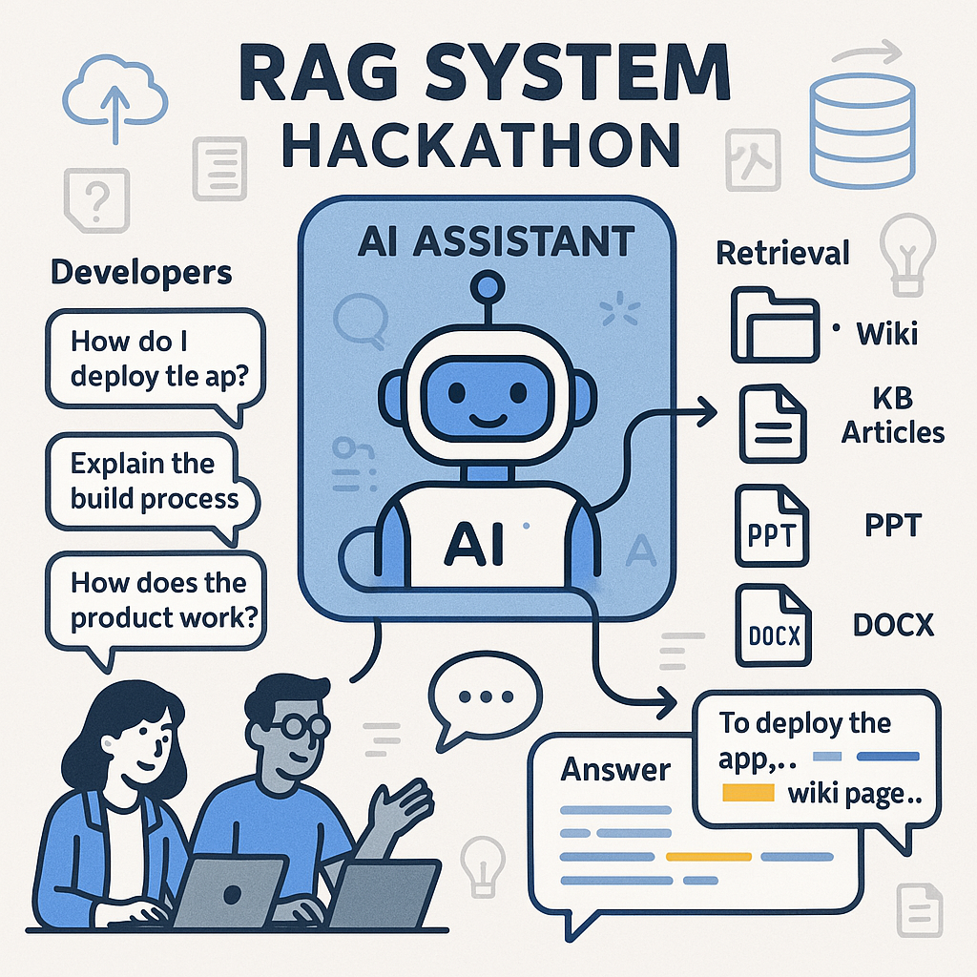

Slide 5
Starting Point for HaQathon
We had brainstormed and finalized the technology stack for our idea prior to the hackathon itself.
And had done some basic POC's to validate the tech stack.
But the entire application for the demo has been coded during the 3 days of the hackathon itself.

Slide 6
Value Proposition of our Solution
Currently there is no one stop solution for developers to get their day to day queries answered. To get their queries answered by searching and going through the ADO wikis, pdf's and ppt's on an average any developer might be needing as low as half an hour or as high as multiple hours as these documents are scattered around sharepoint, wiki, right answers, brownbag sessions and local disk, etc.
But with the use of Qwiki this time can be drastically reduced to just a couple of minutes, which is a massive improvement and saves a lot of developer time and frustration, as even after spending many hours its still not guaranteed that you'll get your query answered.
Overall just for QPTM Pune team with 7 developers and a Lead it might save any where from 10 - 12 hours per Work Item and this is a very conservative estimate.
And the best part is all the queries are answered at a single place and the user does not need to jump around sharepoint, wiki, right answers, brownbag sessions and local disk, etc.

Slide 7
DEMO
QWiki

Slide 8
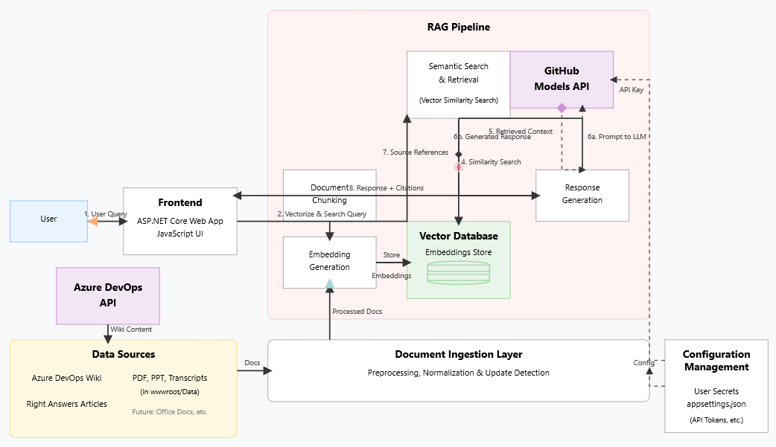

Slide 9
QWiki follows a modern **Retrieval Augmented Generation (RAG)** architecture that combines intelligent document retrieval with AI-powered response generation:
### Core Components:
- **Frontend**: ASP.NET Core web application with JavaScript UI for user interactions
- **Document Ingestion Layer**: Processes multiple document types (Azure DevOps wikis, PDFs, PPTs, transcripts)
and converts them into searchable vector embeddings
- **Vector Database**: Stores document embeddings for fast semantic similarity search
- **RAG Pipeline**: Orchestrates the flow from user query → document retrieval → AI response generation
- **GitHub Models API**: Provides AI capabilities for embedding generation and response creation
### Data Flow:
1. **User Query**: Natural language questions entered through the web interface
2. **Vectorize & Search**: Query is converted to embeddings and searched against the vector database
3. **Context Retrieval**: Most relevant document chunks are retrieved based on semantic similarity
4. **Response Generation**: GitHub Models API generates responses using the retrieved context
5. **Source Citations**: Responses include references to original documents for verification
This architecture ensures accurate, contextual responses while maintaining transparency through source tracking
and enables easy extension to support additional document types and data sources.
## Key Features
- **RAG Architecture**: Uses Retrieval Augmented Generation to combine document search with AI-generated responses
- **Multi-Source Ingestion**: Supports PDF files, Azure DevOps wiki pages, and can be extended for other document types
- **Semantic Search**: Uses vector embeddings to find relevant content based on meaning, not just keywords
- **Reference Tracking**: Provides source citations and page numbers for verification and further reading
- **Real-time Updates**: Automatically detects and processes new or modified documents

Slide 10
Go to Market Strategy
Currently for the demo we've used only single pdf, ppt, kb article and wiki page, but to get it to production we can pull all the relevant documents for QPTM from various sources like sharepoint, ADO wiki, right answers, brownbag sessions and local disk, etc into our application and then use QWiki for all developer queries.
Also it can be extended for other products as we just need to pull the relevant documents of these products in Qwiki.

